Slide 1
MACHINE AND UNDERSTANDABLE KNOWLEDGE STRUCTURE QUERY INTERFACE

Slide 2
INTRODUCTION
Machines require structured information to process data accurately, as they cannot directly understand human language. Therefore, human language must be converted into a machine-readable form for proper processing. Structured Query Interfaces play an important role in this conversion by enabling effective communication between humans and machines. They reduce ambiguity in user queries and ensure faster and more accurate data retrieval. Additionally, these interfaces make systems easy to use for non-technical users and improve the overall efficiency of databases and information systems.

Slide 3
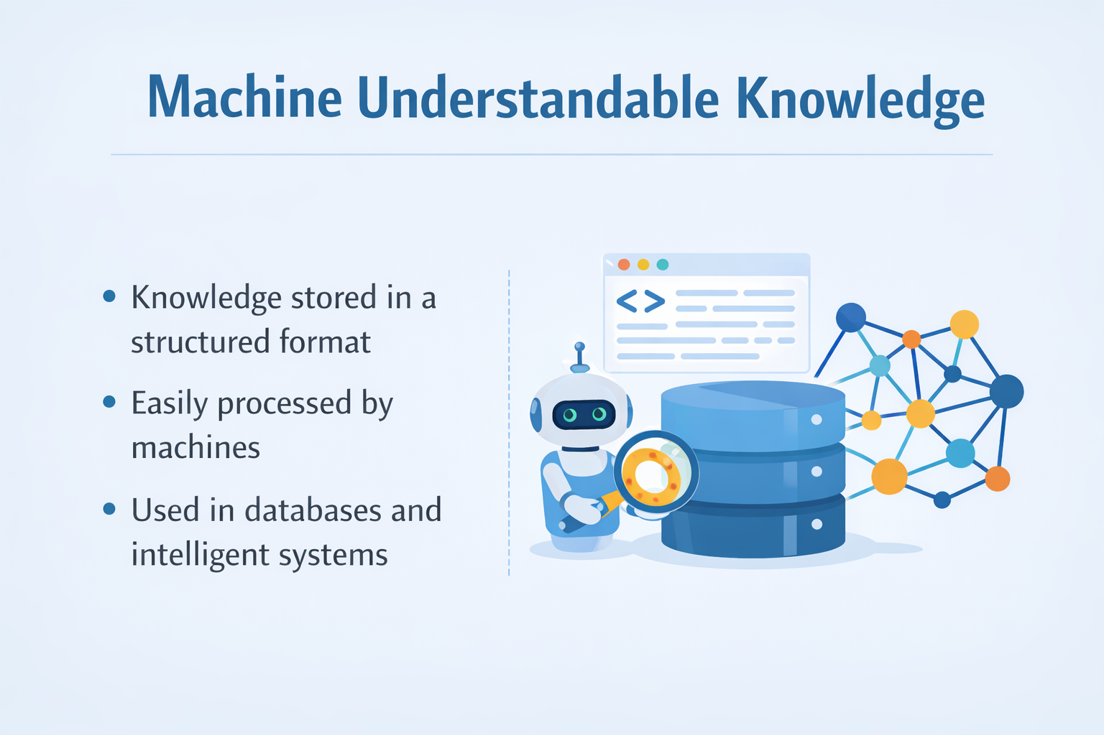
Machine Understandable Knowledge
Knowledge stored in a structured format.
Easily processed by machines.
Used in databases and intelligent systems.

Slide 4
Structured Query Interface
Interface used to retrieve data from databases.
Uses structured queries like SQL.
Provides accurate and fast information retrieval.

Slide 5
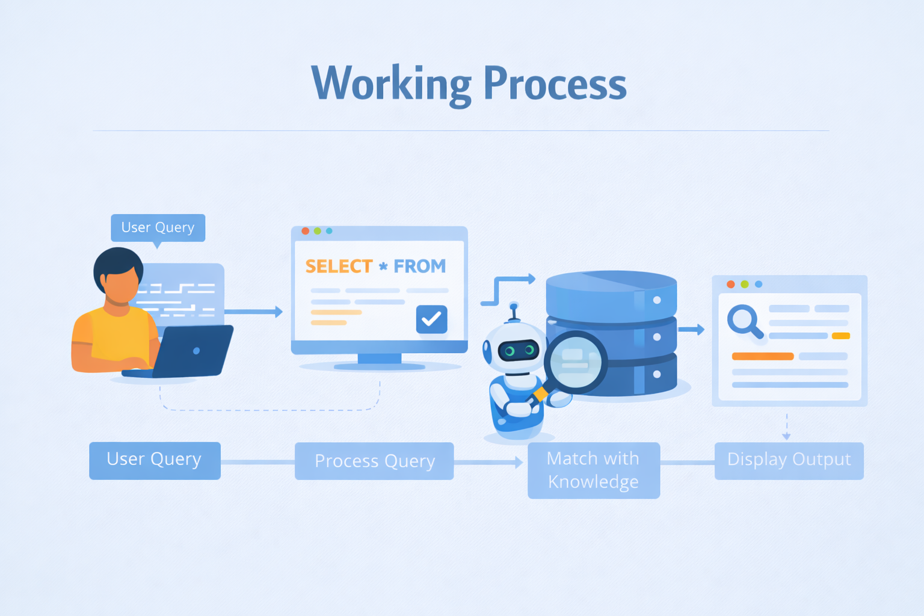
Working Process
User provides a query.
System processes the query.
Matches query with structured knowledge.
Displays the result to the user.

Slide 6
APPLICATIONS
Database management systems
Information retrieval systems
Decision support systems
E-governance platforms

Slide 7
CONCLUSION
Machine understandable knowledge improves system efficiency.
Structured queries ensure reliability and accuracy.
Enhances human–machine interaction.

